Slide 1
Distributed Machine Learning
Cloud Systems -5095
Nachiket Deo
Ramya Vempalla
Fall 2021

Slide 2

What is Distributed Machine Learning
Distributed Machine Learning is defined as a multi node ML system which are designed to improve performance, accuracy and scalability. In other words, it is defined as “machine learning algorithms which are executed in distributed environment either by data parallelism or Model parallelism.

Slide 3
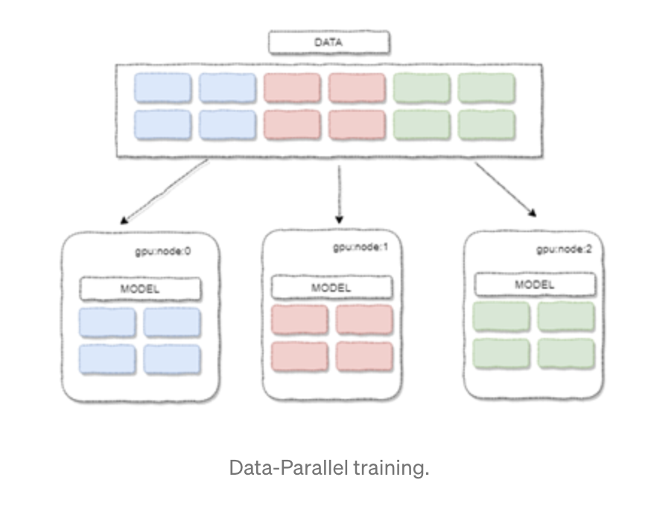
Data parallelism
When the whole data set doesn't fit on a single machine, then the data is distributed across multiple machines/cores.
It reduces the number of I/O operations required to train the model. Therefore, it achieves faster training time.

Slide 4
Model parallelism
Model parallelism is performed when the size of the model is too big to fit on a single machine.
In model parallelism, the model is split across multiple cores or machines. This process is followed only when the model doesn’t fit in the memory and will not highly speed up the training process.

Slide 5
Why Distributed ML?
Due to increase in data size which cannot fit in a single machine
Improves performance, accuracy and scalability
Model size is too big to fit on a single machine
To achieve faster training time

Slide 6
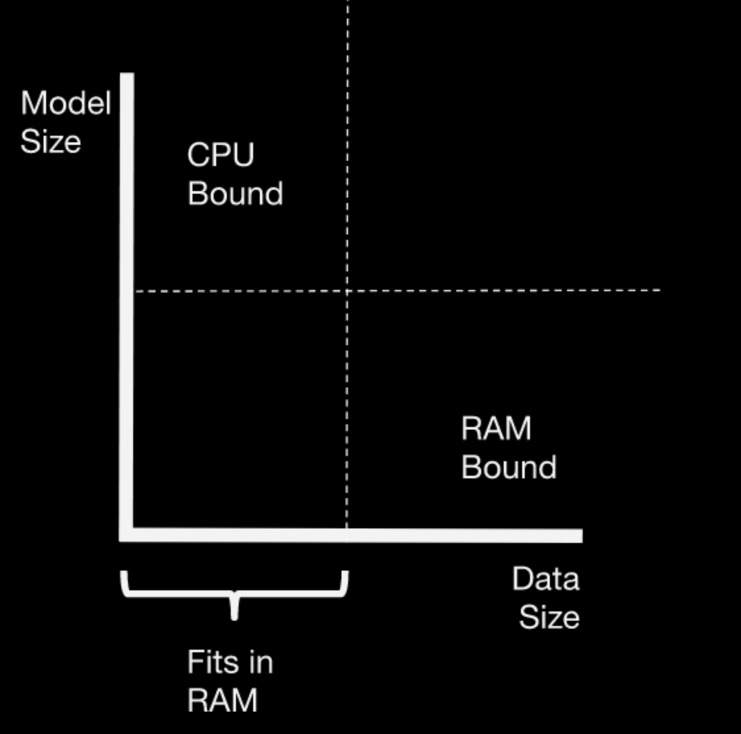
Dask
Dask is a library for parallel and distributed computing in python. It is a very good library to handle large datasets and large models.
Model size issue is handled by using a dask cluster to parallelize the load on multiple cores. Parallelization is done either through the dask joblib backend or Dask-ML estimators
Data size issue is addressed by high level dask collections combined with dask-ml estimators.

Slide 7
Benefits Of Dask
Familiar
Flexible
Native
Fast
Scales up
Scales down
Responsive
In-built dashboard to monitor workers

Slide 8
Dask.Distributed
It is a light-weight library for distributed computing in python. It meets the following needs.
Low latency
Peer to peer data sharing
Complex scheduling
Pure python
Data locality
Easy setup

Slide 9
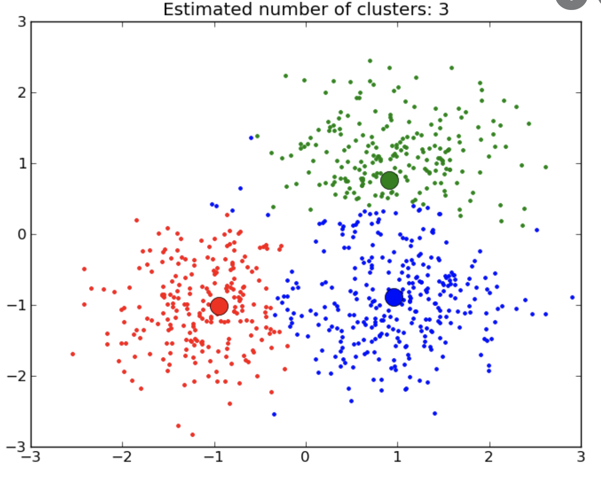
Basic K-Means Algorithm
Input: K= no.of clusters, Points {x1 ... xn} Repeat until convergence { For all points {x1 ... xn} Find nearest centroid and assign x to cluster C (Nearest centroid is calculated through finding the euclidean distance between x and centroid) For each cluster (c1 to Ck) Recompute the centroid by calculating mean of the points in the cluster }

Slide 10
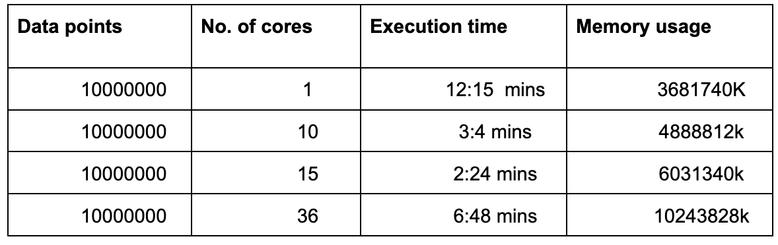
K-Means performance using Dask

Slide 11
Linear regression
Linear regression is a supervised machine learning algorithm.
It attempts to model the relationship between two variables by fitting a linear equation to observed data.
One variable is considered to be an explanatory variable, and the other is considered to be a dependent variable.
Gradient Descent is the process of minimizing a function by following the gradients of the cost function.
This involves knowing the form of the cost as well as the derivative so that from a given point you know the gradient and can move in that direction, e.g. downhill towards the minimum value.

Slide 12
Linear Regression - Dask code
The below code would partition the data and send it to nodes and rebalance function with adjust the shuffling of the data.
X, y = dask.persist(X,y)
client.rebalance([X, y])
Compute several dask collections at once. The calculation across the nodes are done in parallel.
beta_hat, func, new_func =
dask.compute(beta_hat, func, new_func)
The performance report can be generated with simple code
with performance_report(filename = "linear_regression_1.html"):

Slide 13
Linear Regression performance using Dask
Data Points | No of Cores | Execution Time | Memory Usage
1000000 | 1 | 00:00:54 | 2080K
1000000 | 10 | 00:00:33 | 2268K
1000000 | 20 | 00:00:32 | 2264K
1000000 | 36 | 00:00:32 | 2264K

Slide 14
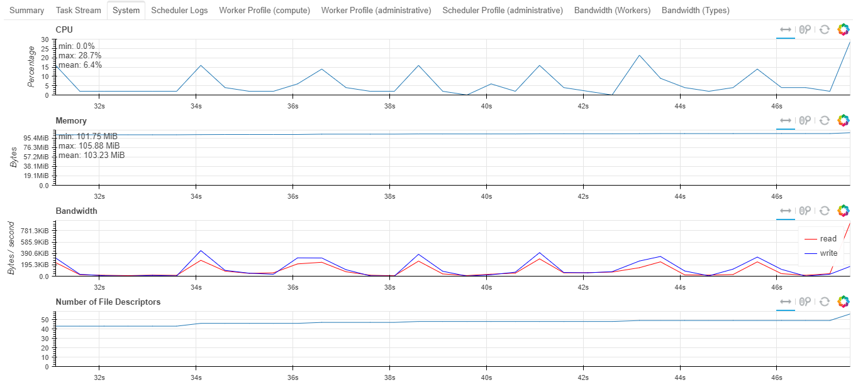
Performance Report

Slide 15
Spectral Clustering
Spectral clustering clusters based on pairwise proximity/similarity/affinity and have roots in graph theory.
Given n data points x_1, … , x_n, the spectral clustering algorithm constructs a similarity matrix Sϵ Rn*n, where Sij >= 0 reflects the relationship between xi and xj. It then uses similarity information to group x_1, ... , x_n into k clusters

Slide 16
Spectral clustering performance using Dask
Data points | No of Cores | Execution Time | Memory Usage
1000000 | 1 | 00:04:44 | 1146412K
1000000 | 10 | 00:01:14 | 1245224K
1000000 | 20 | 00:01:09 | 1690796K
1000000 | 36 | 00:00:36 | 1842684K

Slide 17


